Slide 1
PLL
PHASE LOCKED LOOP
Parte I
Cátedra Electrónica Aplicada III

Slide 2
Objetivos del trabajo
Analizar, calcular, e implementar un PLL
Medir el comportamiento dinámico
Notes:
Explain what TANGO is in a little more detail
Explain what an ontology is – a conceptual representation of data

Slide 3
Introducción
Un PLL (también llamado circuito de fase cerrada, o circuito de fase fija) circuito que permite que una señal de referencia externa controle la frecuencia y la fase de un oscilador .
El PLL es un sistema de control de realimentación en donde la señal de realimentación es una señal de frecuencia en lugar de una tensión .
Notes:
Explain what TANGO is in a little more detail
Explain what an ontology is – a conceptual representation of data

Slide 4
Consiste de los siguientes bloques:
Oscilador controlado por tensión (VCO, voltage-controlled oscillator)
Divisor de frecuencias
Comparador de fase
Filtro pasa bajos, y un amplificador
Notes:
Explain what TANGO is in a little more detail
Explain what an ontology is – a conceptual representation of data

Slide 5
Se utilizan para:
Generar frecuencias, con salto definido
Modulación y demodulación
Recuperación de portadora en transmisión digital
Notes:
Explain what TANGO is in a little more detail
Explain what an ontology is – a conceptual representation of data

Slide 6
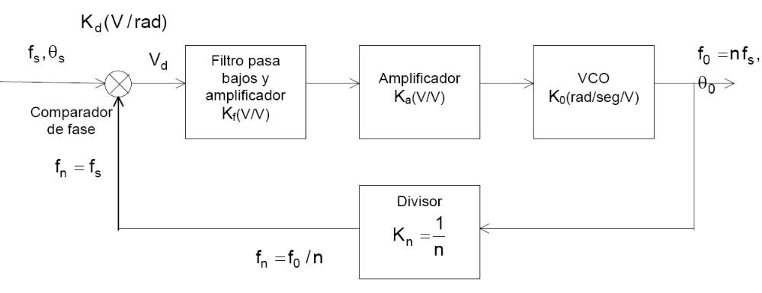
Diagrama el bloques
Notes:
Explain what TANGO is in a little more detail
Explain what an ontology is – a conceptual representation of data

Slide 7
Definiciones. Estados de funcionamiento
Corrida libre:
Frecuencia f0 de salida del VCO, cuando el PLL no está enganchado.
Notes:
Explain what TANGO is in a little more detail
Explain what an ontology is – a conceptual representation of data

Slide 8
Definiciones
Rango de sostén (rastreo o sincronización):
Si la f0/n cambió, porque cambió la división programable n, el VCO se desplazará o rastreará a la fS hasta que nuevamente fS = f0/n. Luego tenderá a ajustarse en fase.
Notes:
Explain what TANGO is in a little more detail
Explain what an ontology is – a conceptual representation of data

Slide 9
Definiciones
Rango de estado captura (de estado fijo):
Si fS = f0/n, y MOD(ωs-ω0/n) es menor que el ancho de banda de 3 dB de la función de transferencia H(s) del PLL, el bucle entrará en estado fijo, sin ciclos de deslizamiento.
Notes:
Explain what TANGO is in a little more detail
Explain what an ontology is – a conceptual representation of data

Slide 10
Definiciones
Rango de tracción:
Si la diferencia de frecuencia queda fuera del estado fijo, pero dentro del de sostén, el PLL seguirá rastreando a (f0/n →fs) hasta que logren igualarse. A partir de aquí ya estará en estado fijo.
Notes:
Explain what TANGO is in a little more detail
Explain what an ontology is – a conceptual representation of data

Slide 11
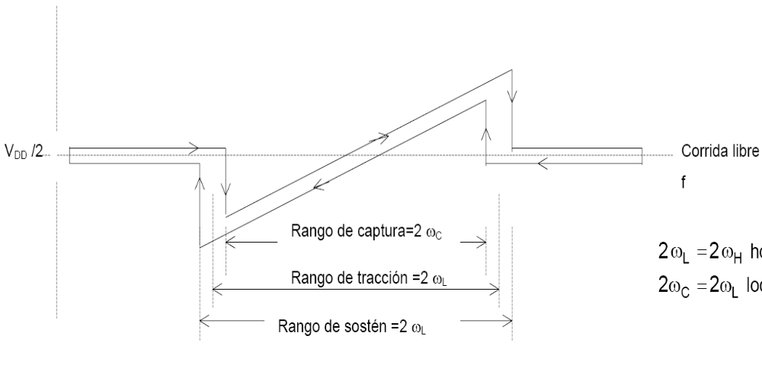
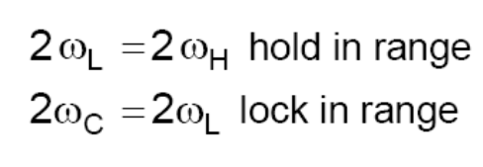
Definiciones
Notes:
Explain what TANGO is in a little more detail
Explain what an ontology is – a conceptual representation of data

Slide 12
Análisis lineal del PLL
El análisis matemático siguiente sólo es aplicable cuando el PLL está enganchado.
Pero, servirá para identificar cada componente y cómo interviene cada una de éstas partes en el lazo cerrado.
Notes:
Explain what TANGO is in a little more detail
Explain what an ontology is – a conceptual representation of data

Slide 13
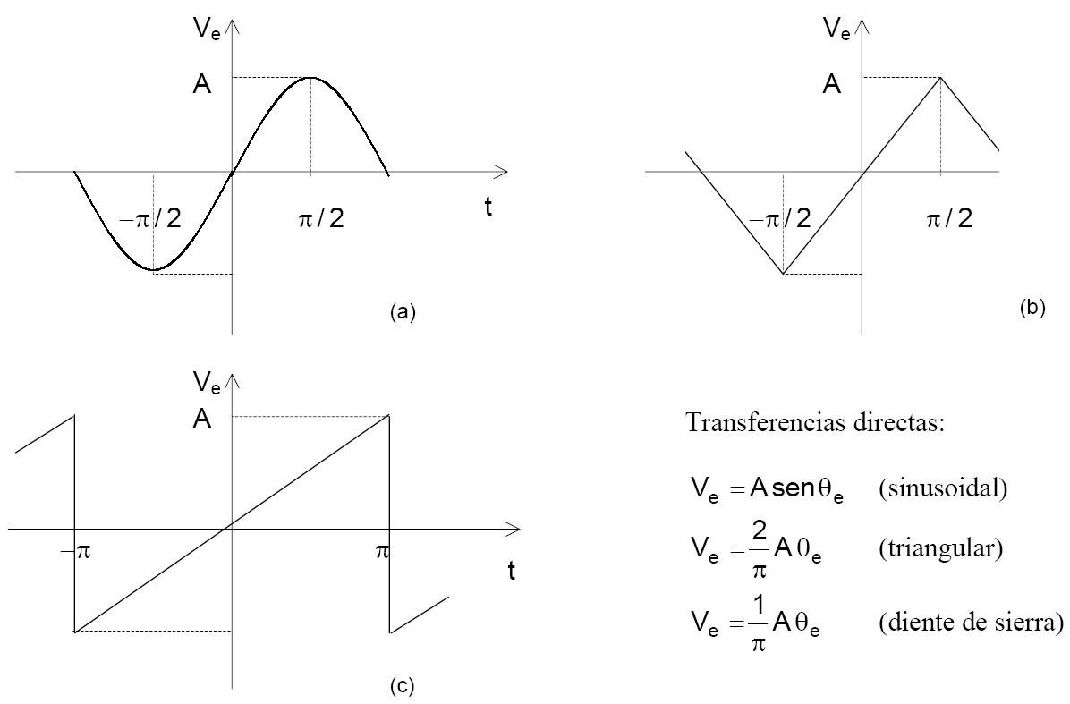
El comparador de fase
Notes:
Explain what TANGO is in a little more detail
Explain what an ontology is – a conceptual representation of data

Slide 14
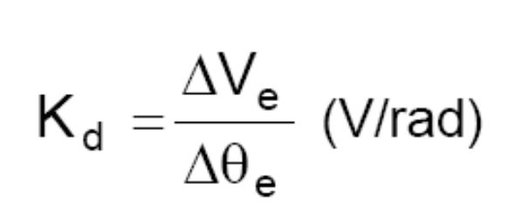
Factor de ganancia del detector de fase en estado permanente:
Notes:
Explain what TANGO is in a little more detail
Explain what an ontology is – a conceptual representation of data

Slide 15
Filtro pasabajos
Elimina cualquier ruido de alta frecuencia y las componentes de alta frecuencia, y sus armónicas, dejando pasar sólo ωs-ω0, o una continua cuando el lazo está fijo y estable.
Es el bloque que más influye en la determinación de las características dinámicas del lazo
Notes:
Explain what TANGO is in a little more detail
Explain what an ontology is – a conceptual representation of data

Slide 16
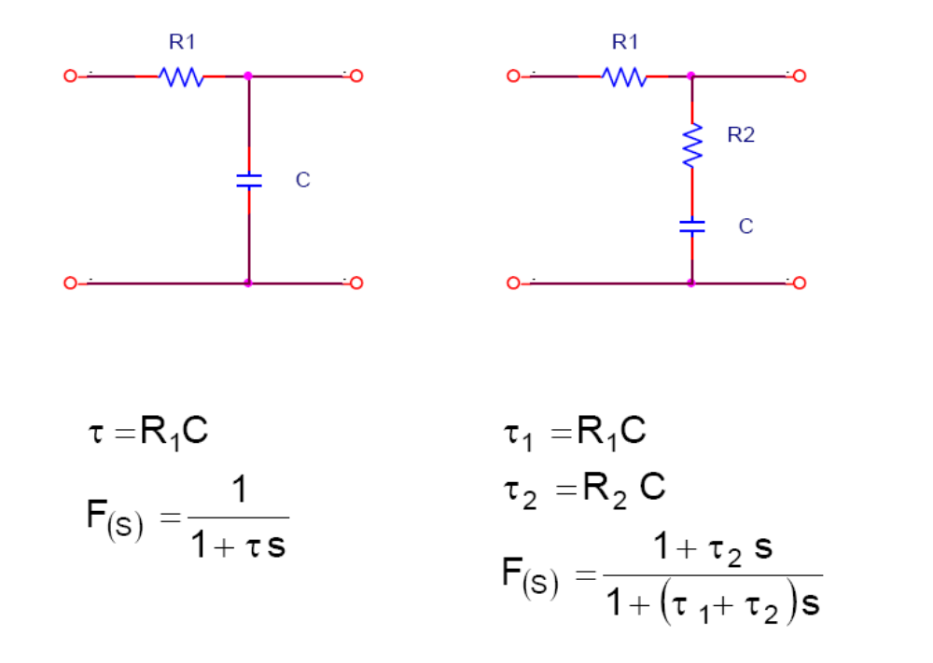
Filtro pasa bajos:
Notes:
Explain what TANGO is in a little more detail
Explain what an ontology is – a conceptual representation of data

Slide 17
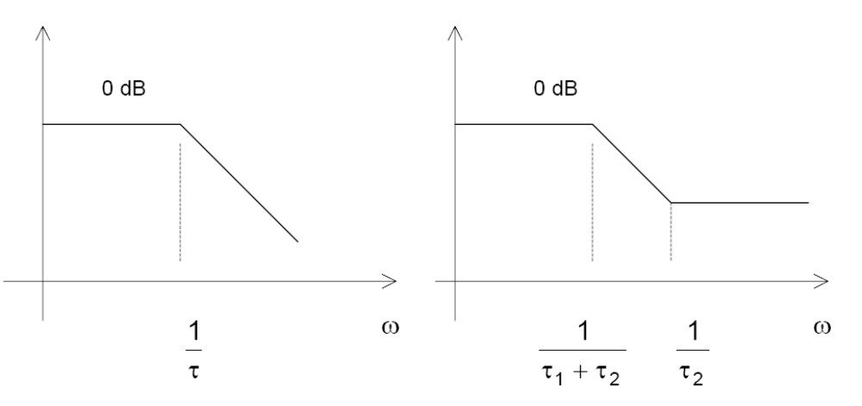
Filtro pasa bajos
Notes:
Explain what TANGO is in a little more detail
Explain what an ontology is – a conceptual representation of data

Slide 18
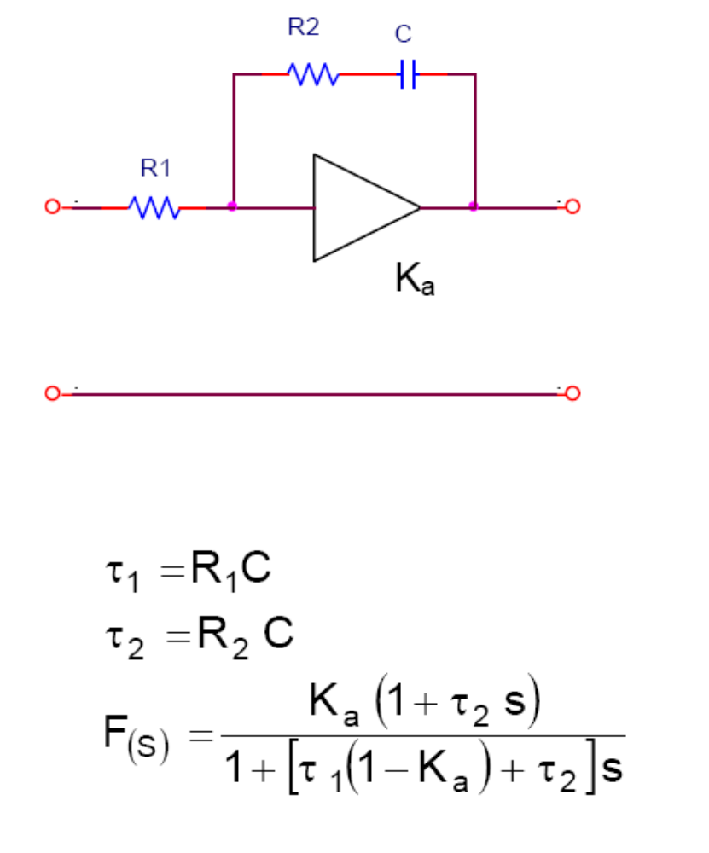
Filtro pasa bajos
Notes:
Explain what TANGO is in a little more detail
Explain what an ontology is – a conceptual representation of data

Slide 19
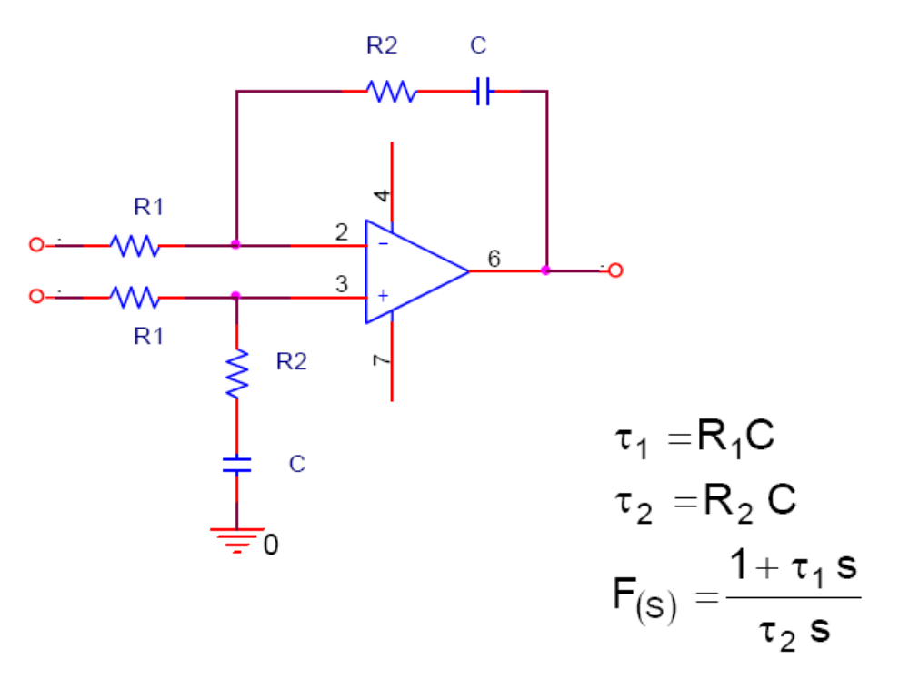
Filtro pasa bajos
Notes:
Explain what TANGO is in a little more detail
Explain what an ontology is – a conceptual representation of data

Slide 20
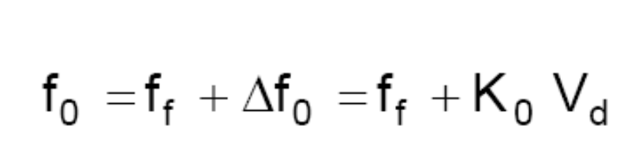
El VCO
El VCO tiene una frecuencia de corrida libre ff y un desplazamiento de frecuencia Δf0 que es proporcional a la tensión de entrada. La frecuencia de salida se puede expresar por:
Notes:
Explain what TANGO is in a little more detail
Explain what an ontology is – a conceptual representation of data

Slide 21
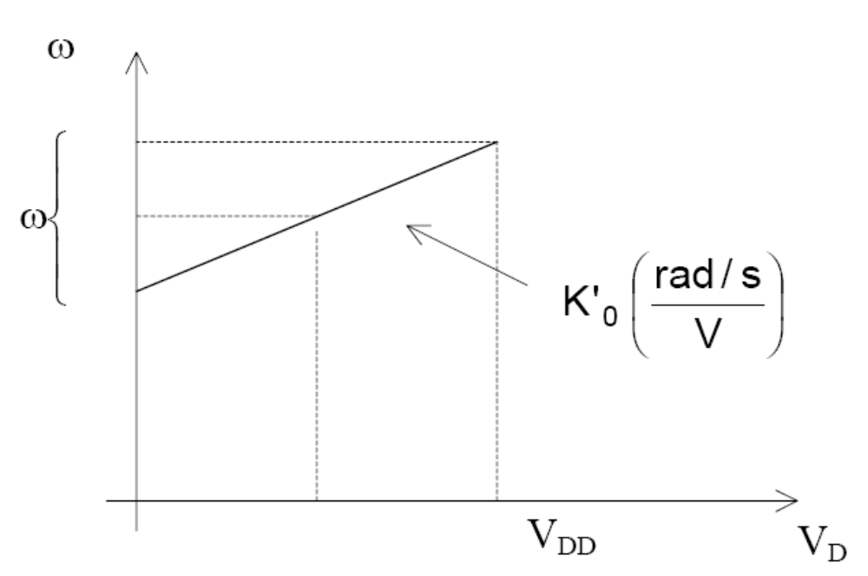
VCO
Notes:
Explain what TANGO is in a little more detail
Explain what an ontology is – a conceptual representation of data

Slide 22
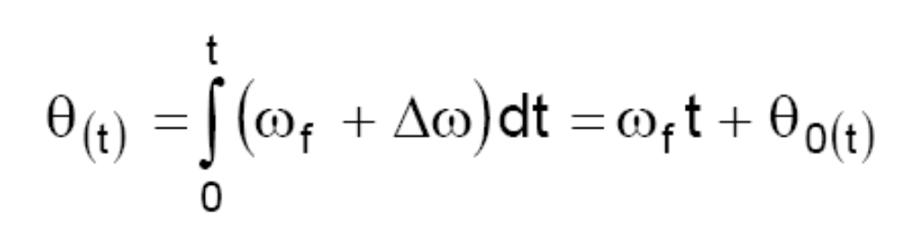
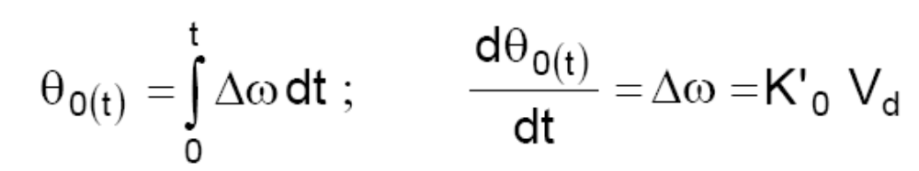
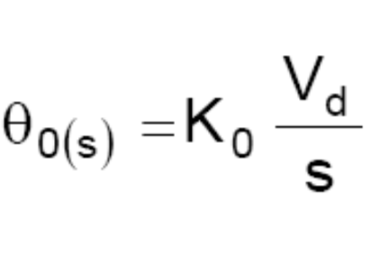
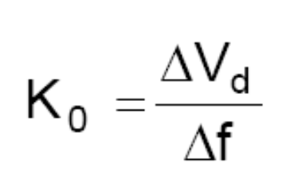
VCO
Notes:
Explain what TANGO is in a little more detail
Explain what an ontology is – a conceptual representation of data

Slide 23
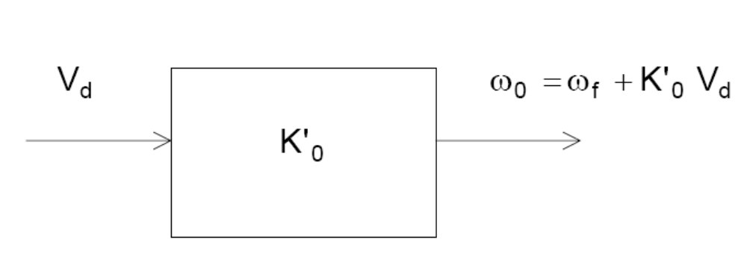
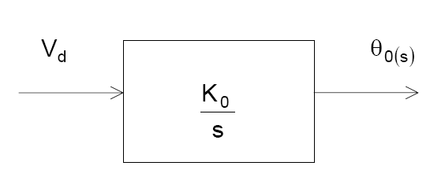
Diagrama en bloques
Notes:
Explain what TANGO is in a little more detail
Explain what an ontology is – a conceptual representation of data

Slide 24
vco
El VCO actúa como un integrador de los errores de fase. Esto ayuda a mantener el estado fijo del bucle durante perturbaciones momentáneas
Notes:
Explain what TANGO is in a little more detail
Explain what an ontology is – a conceptual representation of data

Slide 25
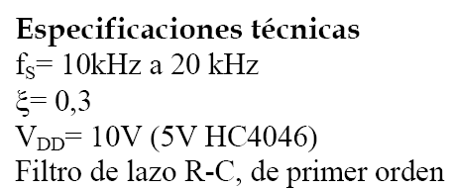
Red PLL – Cálculo e implementación de Multiplicador por 10:
Notes:
Explain what TANGO is in a little more detail
Explain what an ontology is – a conceptual representation of data

Slide 26
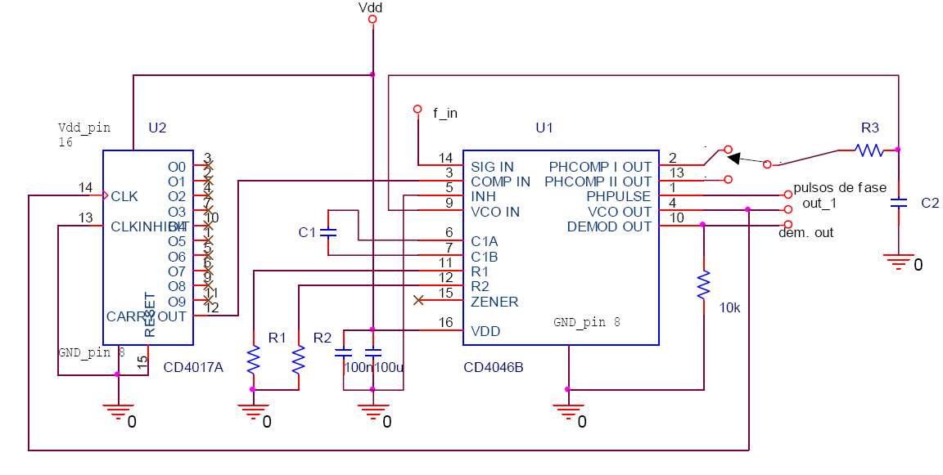
Pasos del diseño :
Notes:
Explain what TANGO is in a little more detail
Explain what an ontology is – a conceptual representation of data

Slide 27
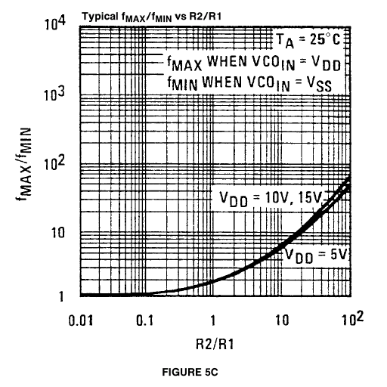
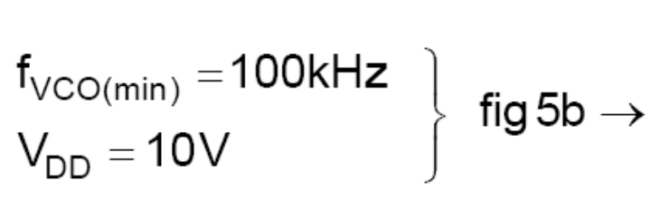
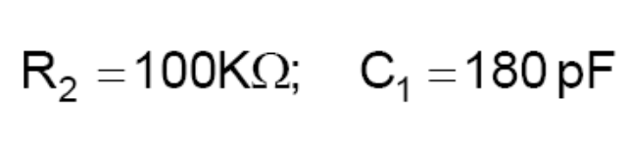
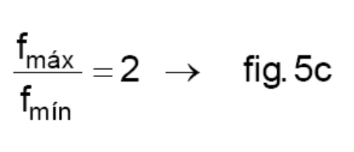
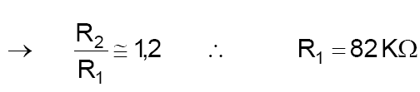
Cálculo de los componentes:
Cálculo de R1, R2, C1
Notes:
Explain what TANGO is in a little more detail
Explain what an ontology is – a conceptual representation of data

Slide 28
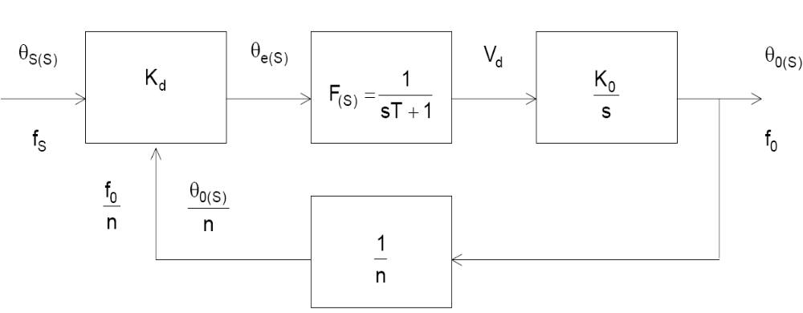
Función de transferencia en estado estacionario
Notes:
Explain what TANGO is in a little more detail
Explain what an ontology is – a conceptual representation of data

Slide 29
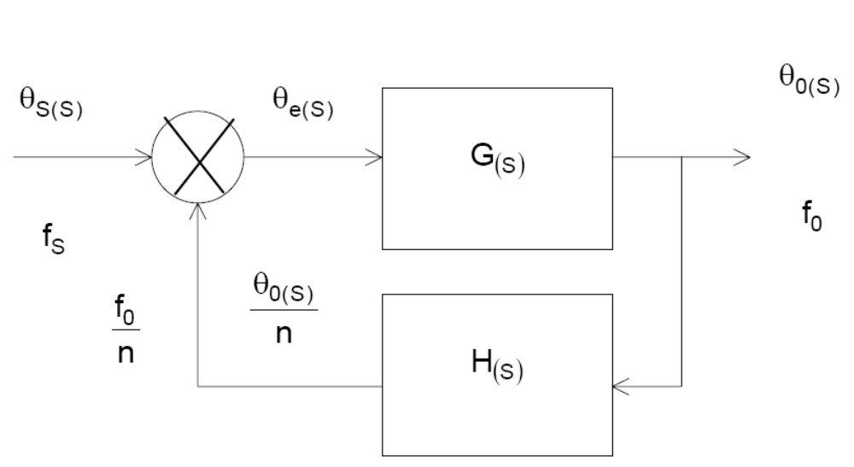
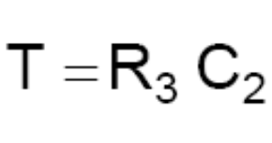
Función de transferencia en estado estaionario
Notes:
Explain what TANGO is in a little more detail
Explain what an ontology is – a conceptual representation of data

Slide 30
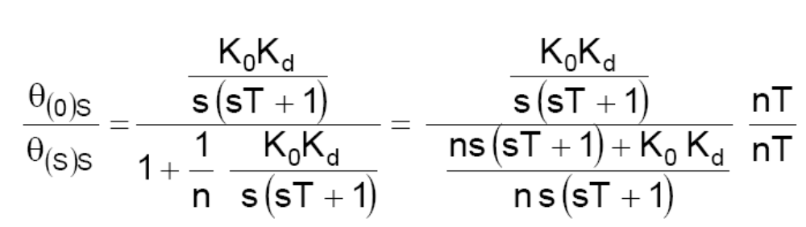
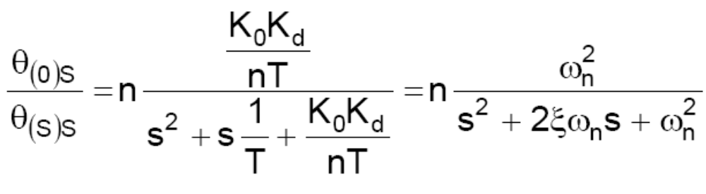
Función de transferencia en estado estaionario
Notes:
Explain what TANGO is in a little more detail
Explain what an ontology is – a conceptual representation of data

Slide 31
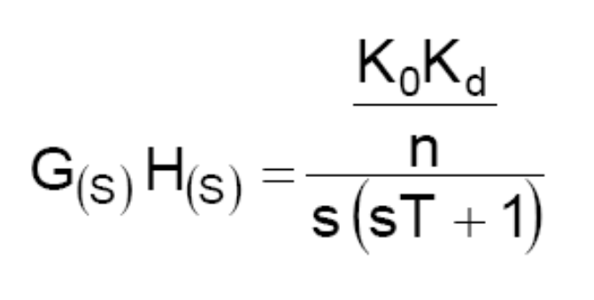
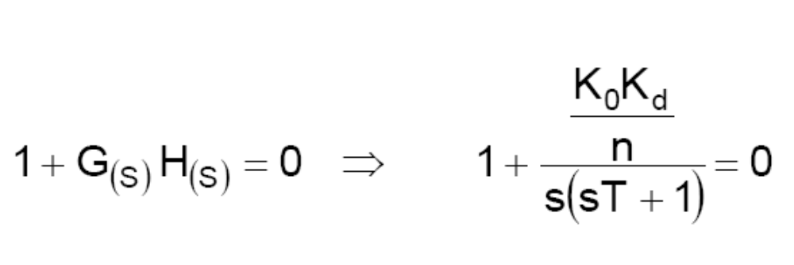
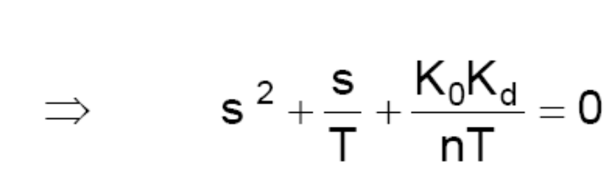
Sistema de segundo orden, tipo 1
Notes:
Explain what TANGO is in a little more detail
Explain what an ontology is – a conceptual representation of data

Slide 32
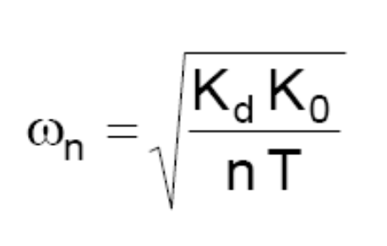
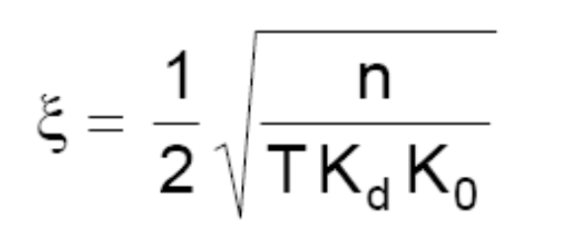
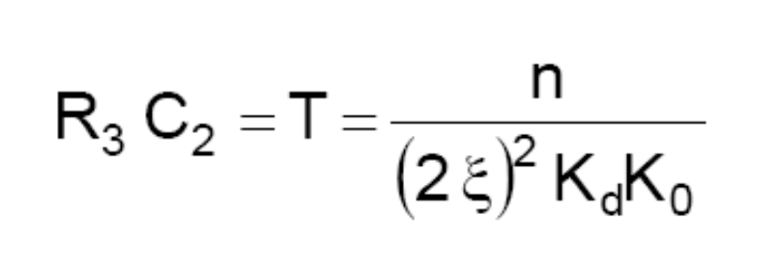
Dinámica
Notes:
Explain what TANGO is in a little more detail
Explain what an ontology is – a conceptual representation of data

Slide 33
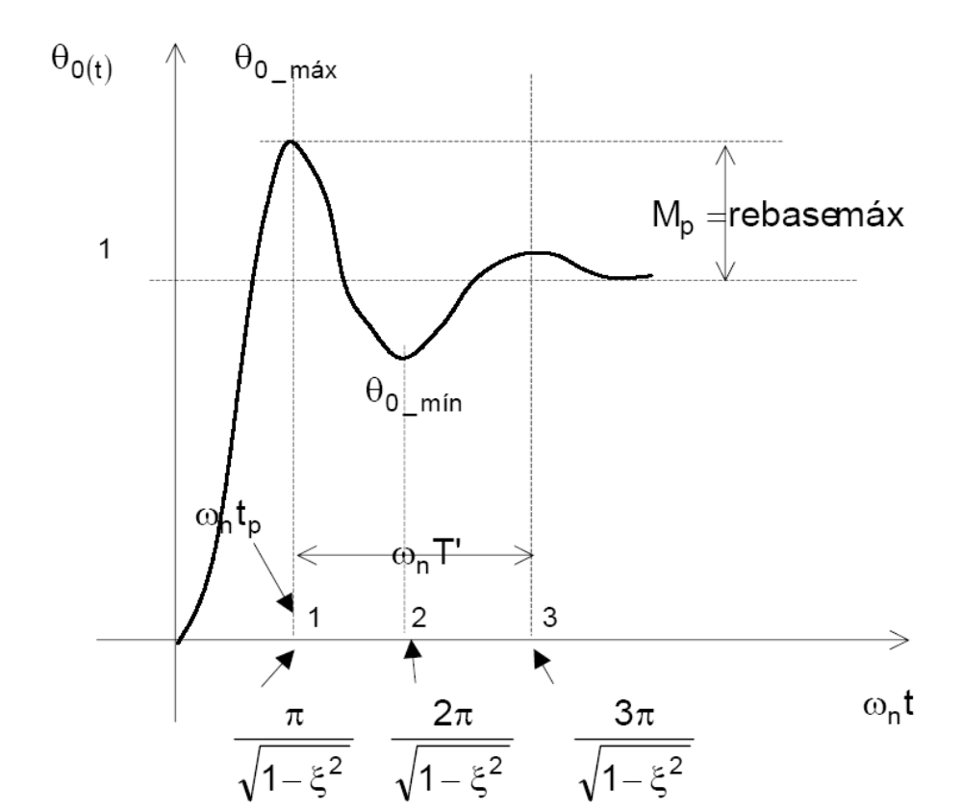
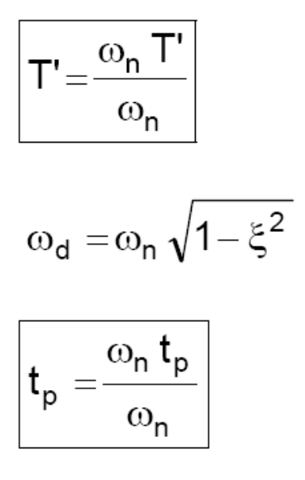
Dinámica
Notes:
Explain what TANGO is in a little more detail
Explain what an ontology is – a conceptual representation of data

Slide 34
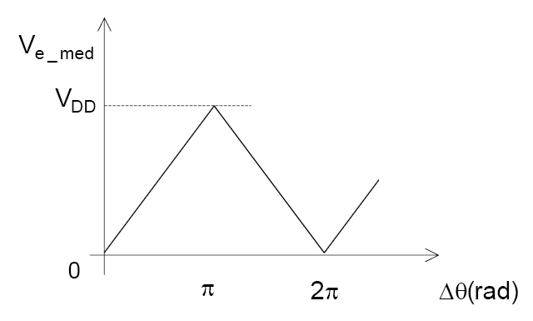
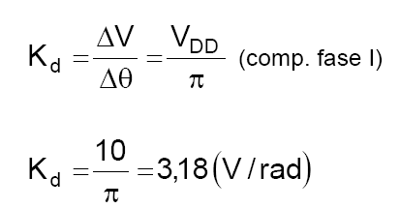
Estimación de Kd (comparador I)
Notes:
Explain what TANGO is in a little more detail
Explain what an ontology is – a conceptual representation of data

Slide 35
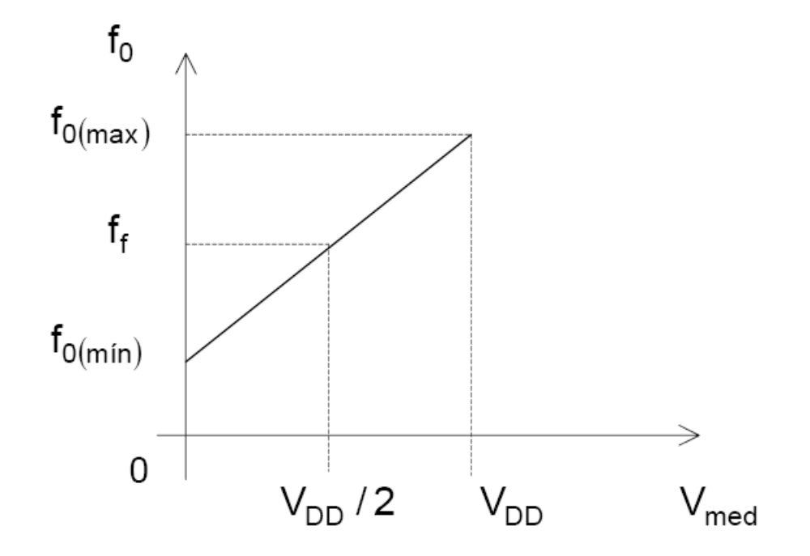
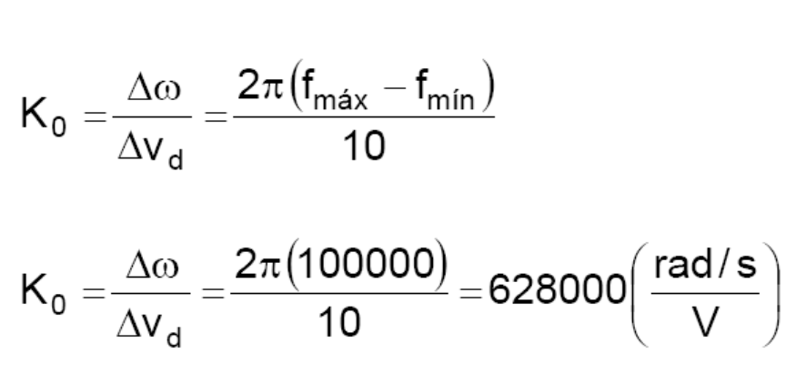
Estimación de K0
Notes:
Explain what TANGO is in a little more detail
Explain what an ontology is – a conceptual representation of data

Slide 36
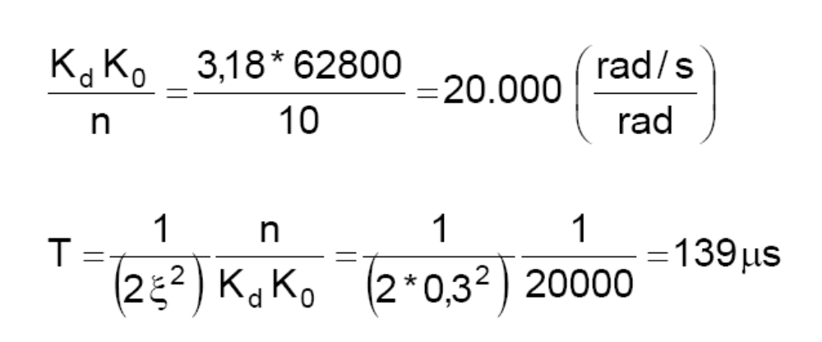
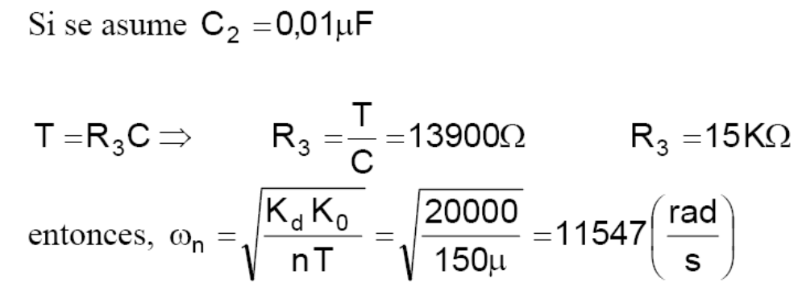
Notes:
Explain what TANGO is in a little more detail
Explain what an ontology is – a conceptual representation of data

Slide 37
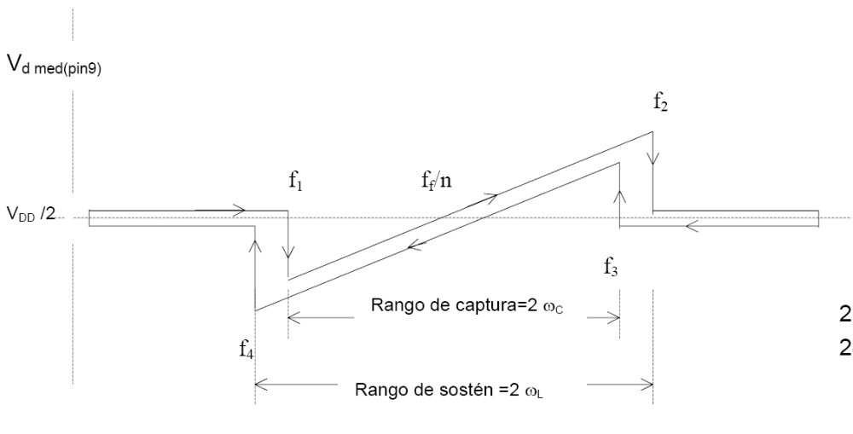
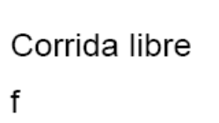
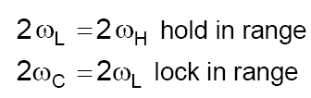
Medición de f1, f2, f3, f4, y ff/n en prototipo
Notes:
Explain what TANGO is in a little more detail
Explain what an ontology is – a conceptual representation of data

Slide 38
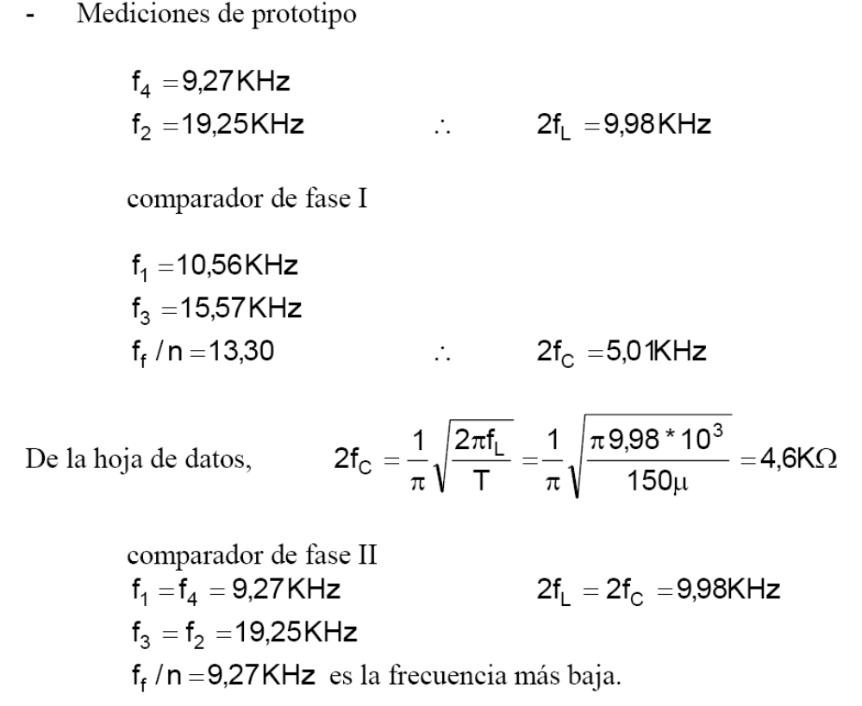
Notes:
Explain what TANGO is in a little more detail
Explain what an ontology is – a conceptual representation of data

Slide 39
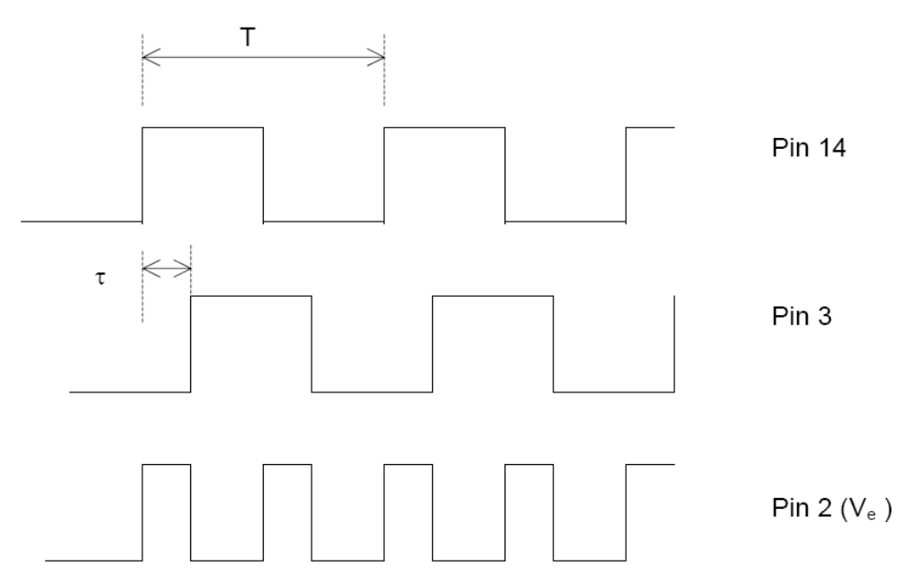
Medición de la ganancia de bucle Kd K0/n. Comp. fase I
Notes:
Explain what TANGO is in a little more detail
Explain what an ontology is – a conceptual representation of data

Slide 40
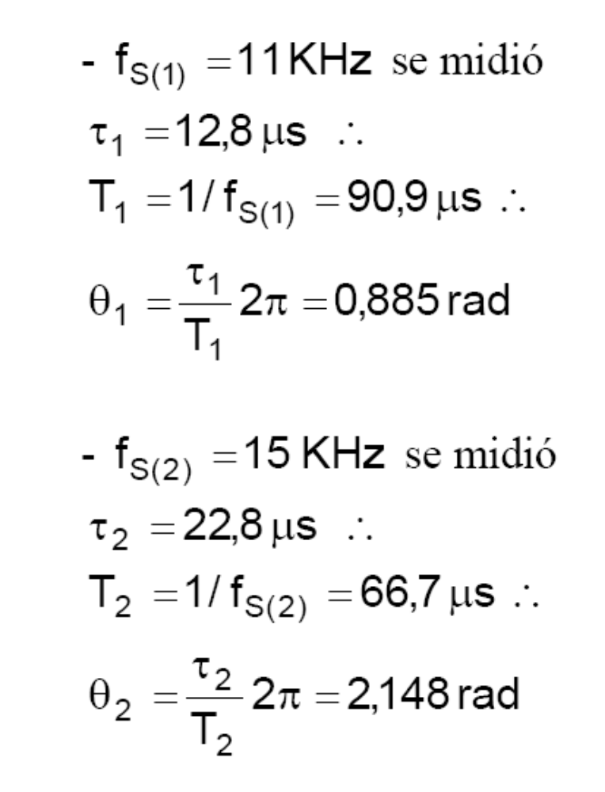
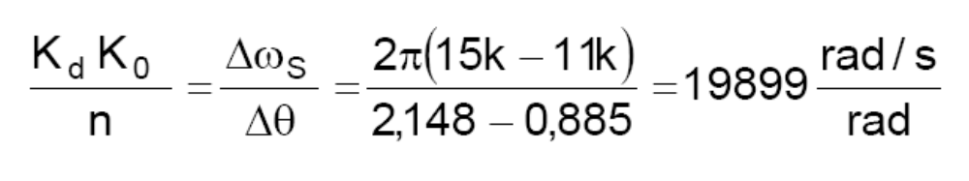
Notes:
Explain what TANGO is in a little more detail
Explain what an ontology is – a conceptual representation of data

Slide 41

Medición de Mp, ω , ξ
Notes:
Explain what TANGO is in a little more detail
Explain what an ontology is – a conceptual representation of data

Slide 42

Notes:
Explain what TANGO is in a little more detail
Explain what an ontology is – a conceptual representation of data

Slide 43


Notes:
Explain what TANGO is in a little more detail
Explain what an ontology is – a conceptual representation of data

Slide 44

Forma de onda
Notes:
Explain what TANGO is in a little more detail
Explain what an ontology is – a conceptual representation of data

Slide 45
Conclusiones:
Se calculan los componentes
Se implementa el PLL
Se miden las constantes K
Se mide la dinámica
Se ajusta para que ξ = 0.4
Conclusiones

